Slide 1
CSE 1121 Structured and Object Oriented Programming Language Department of Computer Science and Engineering DUET, Gazipur-1700
Md. Abu Bakkar Siddique
Lecturer, Department of CSE, DUET
Room # 7024, New Academic Building
Phone/Mobile: +880249274034-53 Ext: 3281, +8801944275646
Email: absiddique@duet.ac.bd, absduet@gmail.com

Slide 2
Lecture 05(Managing Input Output Operations)
Reading a Character in C
Writing a Character in C
Formatted Input
Formatted Output

Slide 3
Reading A Character
The simplest of all input/output operations is reading a character from the 'standard input' unit (usually the keyboard) and writing it to the 'standard output' unit (usually the screen). Reading a single character can be done by using the function getchar. The getchar takes the following form:
variable_name = getchar();

Slide 4
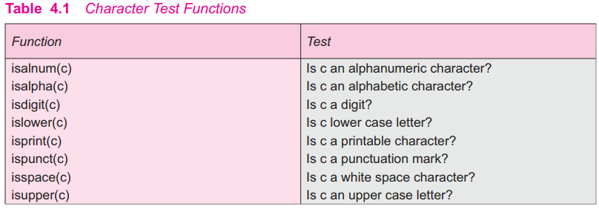
Character Test Function

Slide 5
Writing A Character
Like getchar, there is an analogous function putchar for writing characters one at a time to the terminal. It takes the form as shown below:
putchar (variable_name);
where variable_name is a type char variable containing a character. This statement displays the character contained in the variable_name at the terminal.

Slide 6
Formatted Input
scanf ("control string", arg1, arg2, ...... argn);
The control string specifies the field format in which the data is to be entered. It contains field specifications, which direct the interpretation of input data. It may include:
Field (or format) specifications, consisting of the conversion character %, a data type character (or type specifier), and an optional number, specifying the field width. The field width specifier is optional.
Blanks, tabs and newlines are ignored.
The arguments arg1, arg2,...., argn specify the address of locations where the data is stored.
Control string and arguments are separated by commas.

Slide 7
Inputting Integer Numbers
The field specification for reading an integer number is: % wd
The percentage sign (%) indicates that a conversion specification follows. w is an integer number that specifies the field width of the number to be read and d, known as data type character, indicates that the number to be read is in integer mode. Consider the following example:
scanf("%2d %5d", &num1, &num2);
50 31426
The value 50 is assigned to num1 and 31426 to num2. Suppose the input data is as follows:
31426 50
The variable num1 will be assigned 31 (because of %2d) and num2 will be assigned 426 (unread part of 31426). The value 50 that is unread will be assigned to the first variable in the next scanf call. This kind of errors may be eliminated if we use the field specifications without the field width specifications. That is, the statement will read the data
scanf("%d %d", &num1, &num2);
31426 50
correctly and assign 31426 to num1 and 50 to num2.

Slide 8
Inputting Integer Numbers
An input field may be skipped by specifying in the place of field width.
For example, the statement
scanf("%d %*d %d", &a, &b)
will assign the data as follows:
123 456 789
123 to a
456 skipped (because of *)
789 to b
NOTE: It is legal to use a non-whitespace character between field specifications. However, the scanf expects a matching character in the given location. For example,
scanf("%d-%d", &a, &b);
accepts input like 123-456
to assign 123 to a and 456 to b.

Slide 9
Inputting Real Numbers
Unlike integer numbers, the field width of real numbers is not to be specified and therefore scanf reads real numbers using the simple specification %f for both the notations, namely, decimal point notation and exponential notation. For example, the statement with the input data
scanf("%f %f %f", &x, &y, &z);
475.89 43.21E-1 678
will assign the value 475.89 to x, 4.321 to y, and 678.0 to z. The input field specifications may be separated by any arbitrary blank spaces.
If the number to be read is of double type, then the specification should be %lf instead of simple %f. A number may be skipped using %*f specification.
Inputting Character Strings
We have already seen how a single character can be read from the terminal using the getchar function. The same can be achieved using the scanf function also. In addition, a scanf function can input strings containing more than one character. Following are the specifications for reading character strings:
%ws or %wc

Slide 10
Reading Mixed datatypes
It is possible to use one scanf statement to input a data line containing mixed mode data. In such cases, care should be exercised to ensure that the input data items match the control specifications in order and type. When an attempt is made to read an item that does not match the type expected, the scanf function does not read any further and immediately returns the values read. The statement
will read the data
scanf("%d %c%f %s", &count, &code, &ratio, name);
15 p 1.575 coffee
correctly and assign the values to the variables in the order in which they appear. Some systems accept integers in the place of real numbers and vice versa, and the input data is converted to the type specified in the control string.

Slide 11
Formatted Output
We have seen the use of printf function for printing captions and numerical results. It is highly desirable that the outputs are produced in such a way that they are understandable and are in an easy-to-use form. It is therefore necessary for the programmer to give careful consideration to the appearance and clarity of the output produced by his program.
The printf statement provides certain features that can be effectively exploited to control the alignment and spacing of print-outs on the terminals. The general form of printf statemen is:
printf("control string", arg1, arg2, ....., argn);
Control string consists of three types of items:
1. Characters that will be printed on the screen as they appear.
2. Format specifications that define the output format for display of each item.
3. Escape sequence characters such as \n, \t, and \b.
The control string indicates how many arguments follow and what their types are. The arguments arg1, arg2,..., argn are the variables whose values are formatted and printed according to the specifications of the control string. The arguments should match in number, order and type with the format specifications.

Slide 12
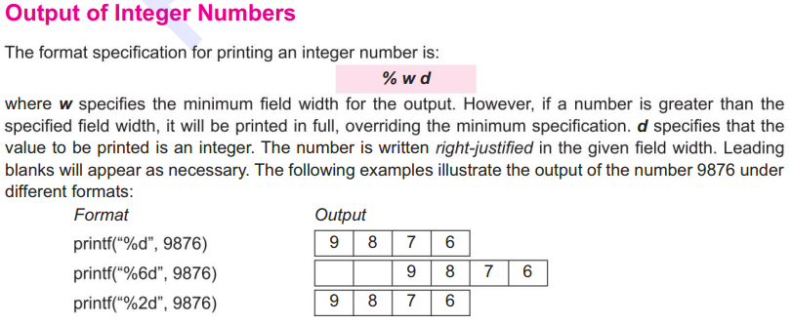


Slide 13
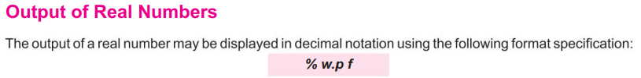
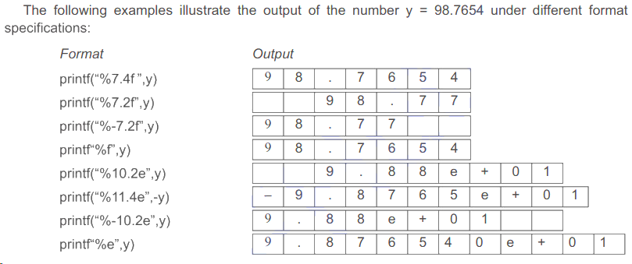

Slide 14
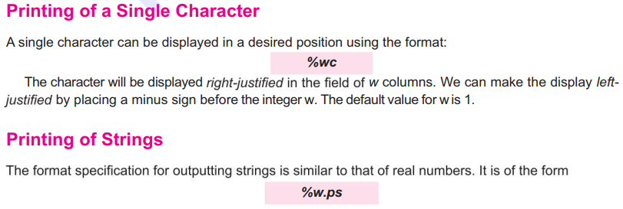

Slide 15
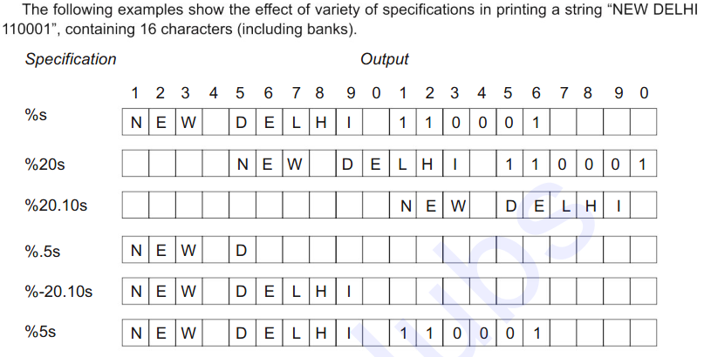

Slide 16

Any Question?

Slide 17
Thank You All !

